Slide 1


HEART DISEASE PREDICTION

Slide 2

By
Sai Karthik Nagabhairava
Ramsai Repalle
Bharath Kumar Pakam
Deepshika Yedla

Slide 3
Overview
A disease is a particular abnormal condition that negatively affects the structure or function of all or part of an organism, and that is not due to any immediate external injury. There are various heart diseases and in those main and most common disease are cardiovascular diseases and heart attack. We use Machine learning techniques which are very efficient in providing accurate results..
The dataset we have taken is a public dataset UCI heart disease dataset, Cleveland heart disease dataset Although, there are many different combinations of ML algorithms are published in papers, there are mostly efficient. But our team Wanted to propose a new model which provides more accuracy than any other existing models.

Slide 4
Define a Problem
One of the predominant diseases that can lead to a reduction in the lifespan of human beings today is heart disease. It is a condition that affects heart function. For many aspects of health promotion and clinical medicine, an estimation of a person’s risk for coronary heart disease is significant.
It is a model for risk prediction. Due to the rapidly growing digital technologies, healthcare facilities keep a vast amount of data in their databases, which is very complex and difficult to examine.
Data mining techniques and machine learning algorithms play important roles in the analysis of different data in medical centers. Techniques and algorithms may be directly used on a dataset to construct certain models or draw important conclusions and inferences from the dataset.

Slide 5
Main Idea
To fulfill the need the proposed system is to predict heart disease through an automated medical diagnosis system based on machine learning. For the prediction system, a hybrid model is used. Further heart disease prediction program, the Cleveland database is used. Since the Cleveland database is the ML researchers most widely used database.
Our team goal is to provide an hybrid model which increases accuracy than any other existing model so we had implemented a hybrid model which combines Random Forest, SVM, Logistic Regression.

Slide 6
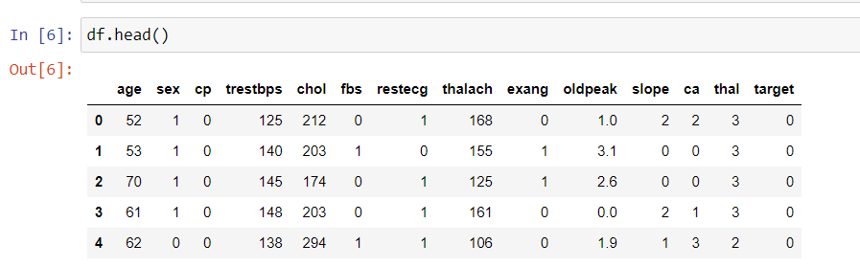
Dataset
Data contains:
Age
Sex
Chest Pain
Trestbps
Cholestrol
FBS
Target – shows have disease or not

Slide 7
Work Flow
Data Collection
Data Visualization
Data Pre-Processing
Data Splitting
Model Training
Model Evaluation and Testing

Slide 8
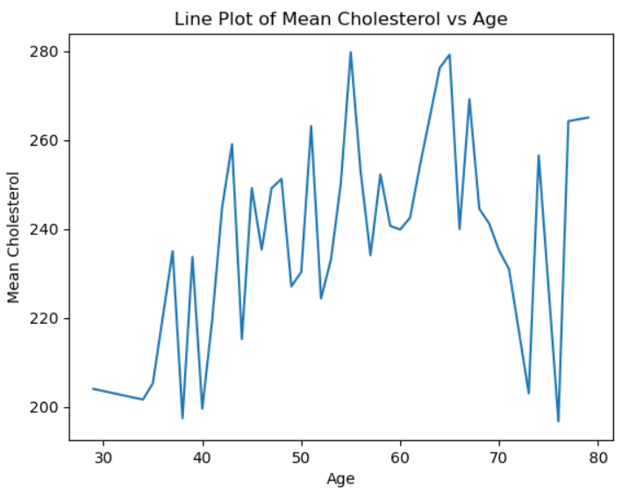
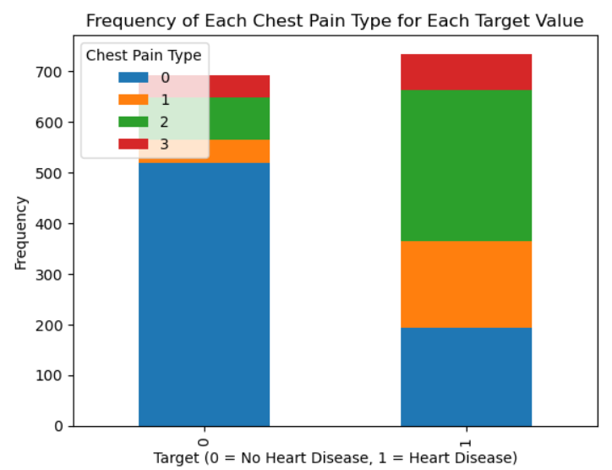
Visualisation’s

Slide 9
Models we are using:
Logistic regression(Backward and forward Propagation)
K-nearest neighbour(Feature Selection and Cross Validation)
support vector machine(SVM)
Decision Tree Algorithm(cost complexity method)
Random Forest(cross-validation and hyper parameter tuning)
Hybrid Model

Slide 10
We used some advanced methods while executing models to overcome Overfitting, Data imbalance… those are cross validation and Hyper parameter tuning.
While executing KNN we got accuracy like 95% which shows there is overfitting in it and small dataset our aim is our model must work on large data sets and produce high accuracy.
With KNN we worked on:
Reducing K
Feature Selection
Cross Validation
While working with decision tree we also used pruning to prevent overfitting in decision trees (we mainly used cost-complexity method).

Slide 11
Hybrid Model
To train the base models, grid search with cross-validation is used to search for the best hyperparameters.
In this implementation, the ensemble consists of a voting classifier that uses the soft voting method
The four base models used in this implementation - XGBoost, Random Forest, SVM, and Logistic Regression.
By using multiple types of classifiers, the hybrid model is able to capture different aspects of the data and reduce the risk of overfitting to a specific model or algorithm.
Finally, the performance of the hybrid model is evaluated on a test set using the accuracy score.

Slide 12
Models used in Hybrid Model
XGBoost: XGBoost is one of the four classifiers used to build the model. The idea behind using XGBoost as one of the base estimators is to take advantage of its accuracy and ability to handle large datasets.
Logistic Regression: The idea behind using logistic regression as one of the base estimators is that it is a simple yet powerful algorithm that can work well in situations where the data is well-behaved and the decision boundary is linear.
Support Vector Machine: The idea behind using SVM as one of the base estimators is that it can be very effective in cases where the decision boundary is non-linear and the data is not well-behaved.
Random Forest: The idea behind using Random Forest as one of the base estimators is that it can be very effective in handling high-dimensional data with many features..

Slide 13
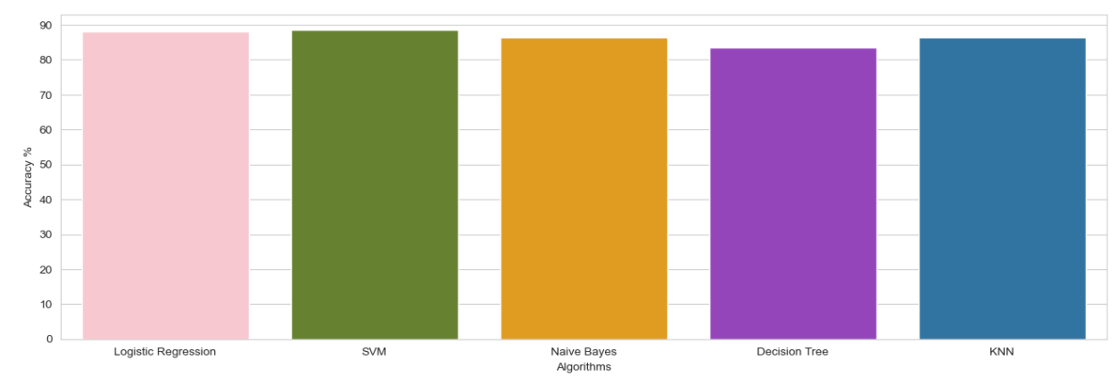
Old Results

Slide 14

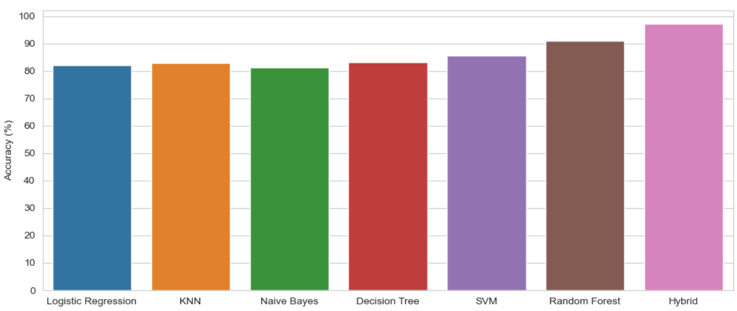


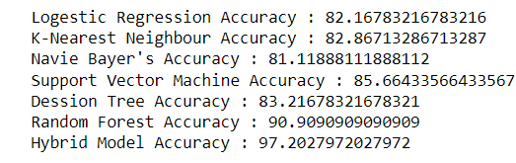

Results

Slide 15

Summary
The main objective of this research is to enhance the accuracy of heart disease prediction in terms of results. Many studies have been carried out that limit the selection of features for algorithmic use.
Here we had implemented multiple models and shown their accuracy we are worked on Random forest and Hybrid model based on random forest which produces more accuracy than any existing models.
We had used the models which will work both on large and small datasets because we also taken care about overfitting, underfitting and all the problems related to small datasets.
The comparison between few models also be done and shown with their accuracy. we came up with our hybrid model which produces more accuracy than any other model.

Slide 16


